Slide 1

LifeLines Breathalyzer
By Adriene Almacen

Slide 2
Introduction (Proposal)
Problem Solved – eliminate drunk driving by providing safe methods of transportation or places to stay.
How it’s used-A MQ3-Gas Alcohol sensor will be used to determine the users Blood Alcohol Content (BAC) as well as a heart beat sensor to determine the users heart rate.
Group members I will be working with next semester Eugene Oliver and Ryan Do.

Slide 3
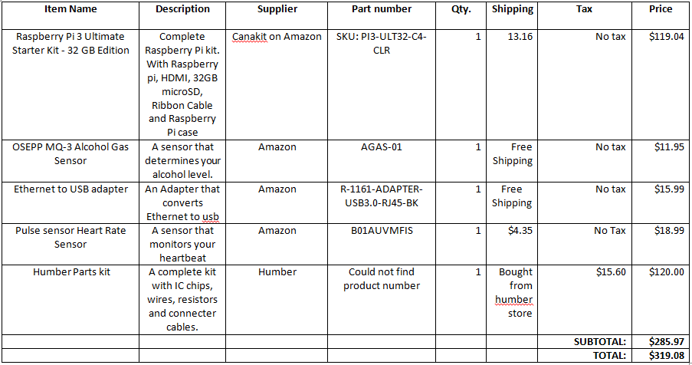
Budget

Slide 4
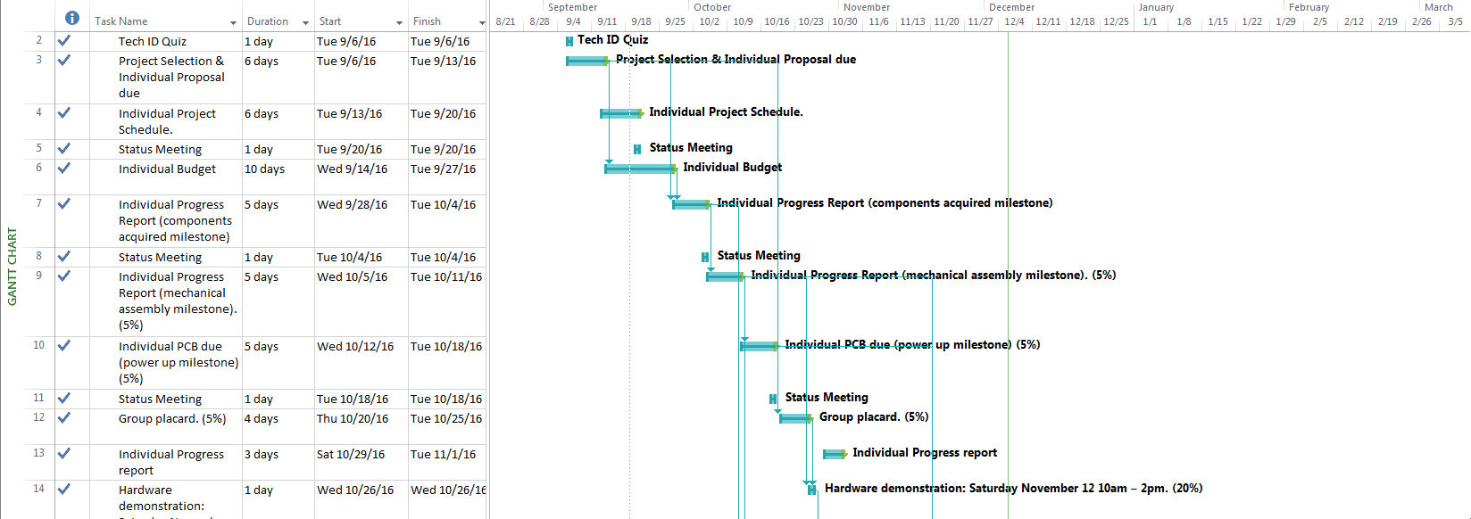
Schedule

Slide 5
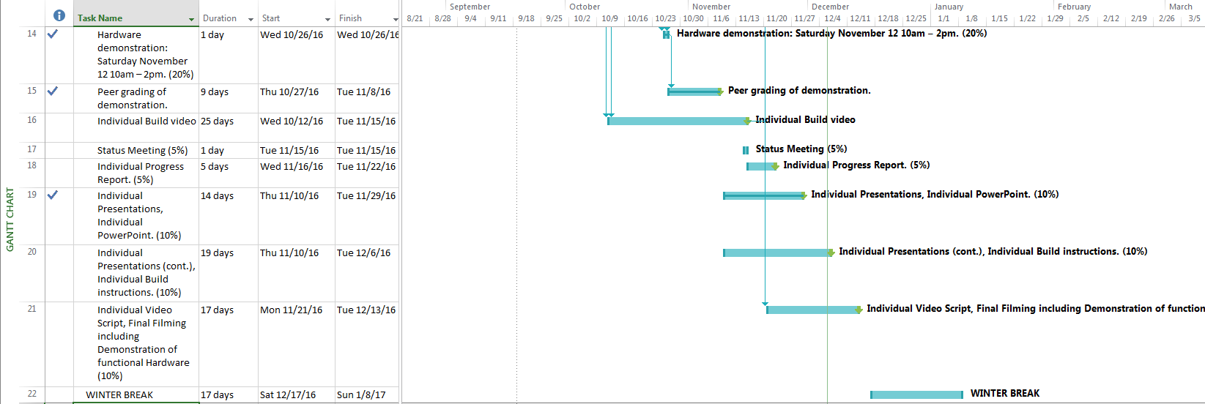
Schedule

Slide 6
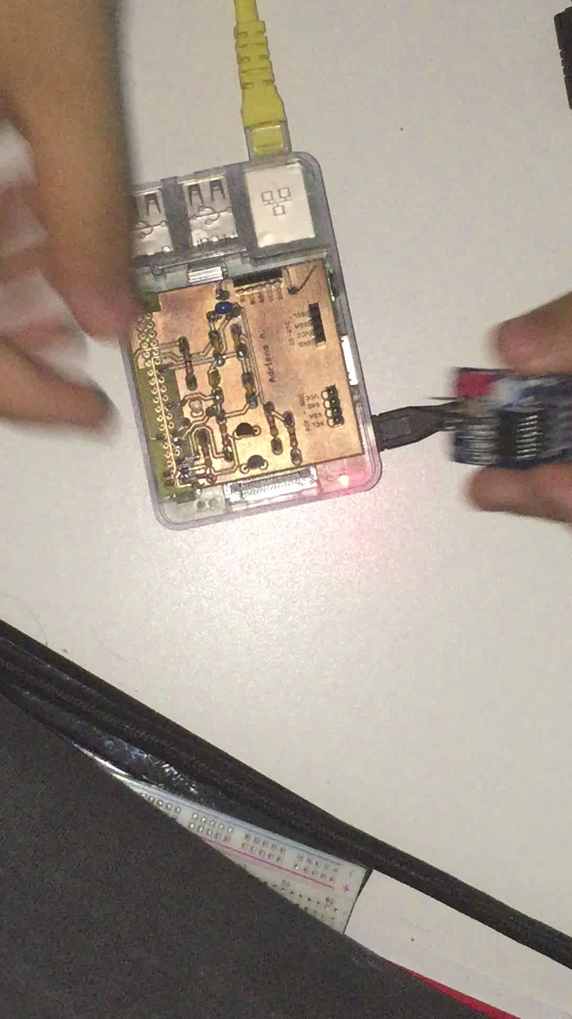
Build Video

Slide 7
Knowledge used from previous courses
Tech 101 – Electric Circuits
Tech 150 – Electronic Devices and Circuits Creating the circuits in order for the sensors to work.
Tech 153 – Technical C Creating the code to read from the sensors
CENG 216 – Intro to Software Engineering. Project management
WRIT 120 & 220 – Technical Reading and Writing Skills Writing the progress reports.

